Slide 1
DOE Hydrokinetic Blade
½ Scale Fabrication

Slide 2
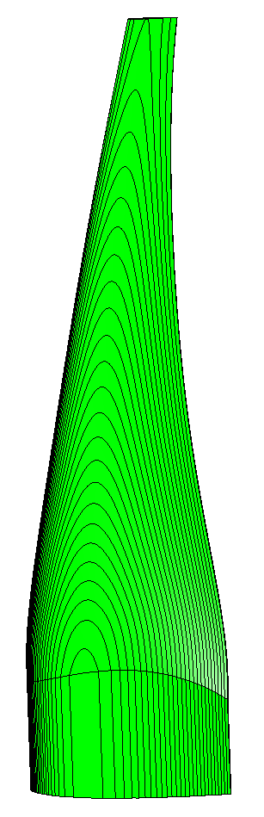
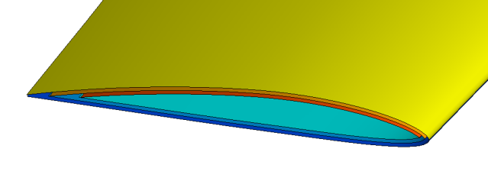
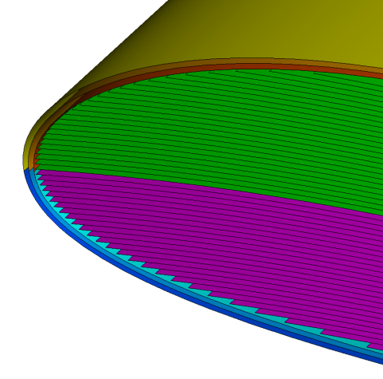
Ply Development Plan
3 structural ply each side
27 core plys each side
3 structural plys
27 plys
27 plys
pressure
suction

Slide 3
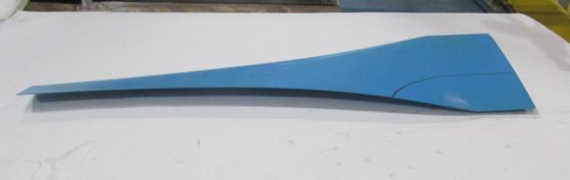
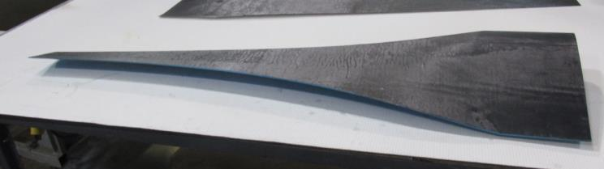
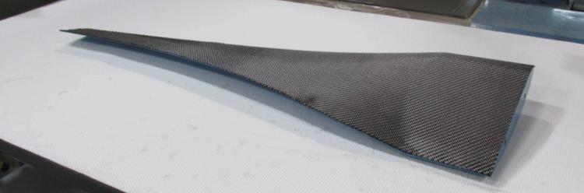
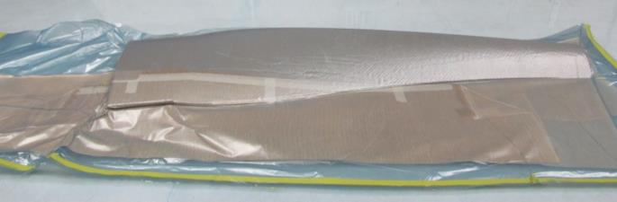
Mold Construction
A mold was constructed from the NC-machined plug. The first layer is surfacing film, followed by two plys of Gurit ST94/RC660T carbon/epoxy prepreg.
plug
surfacing film
ST94/RC660T

Slide 4
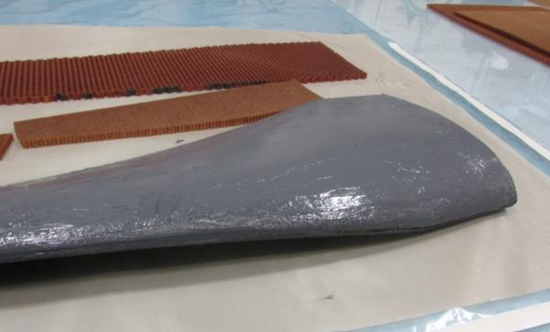
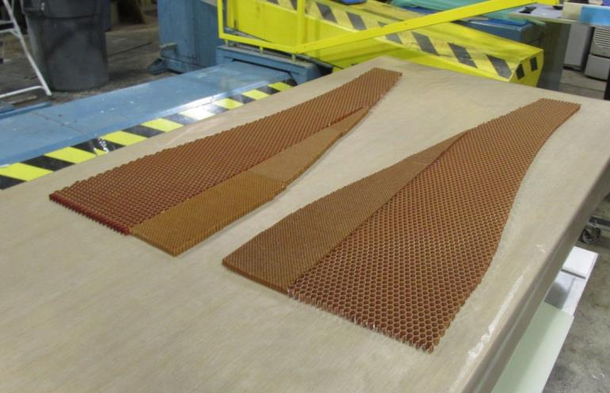

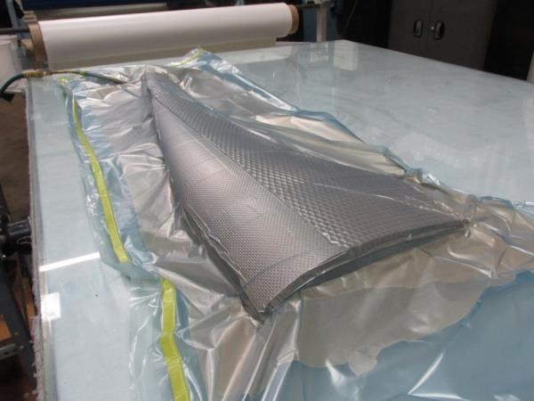
Mold Construction
The mold was completed by bonding honeycomb core to the inner mold skin (flex core was used at the leading edge) followed by a two-ply outer skin of ST94/RC660T.

Slide 5
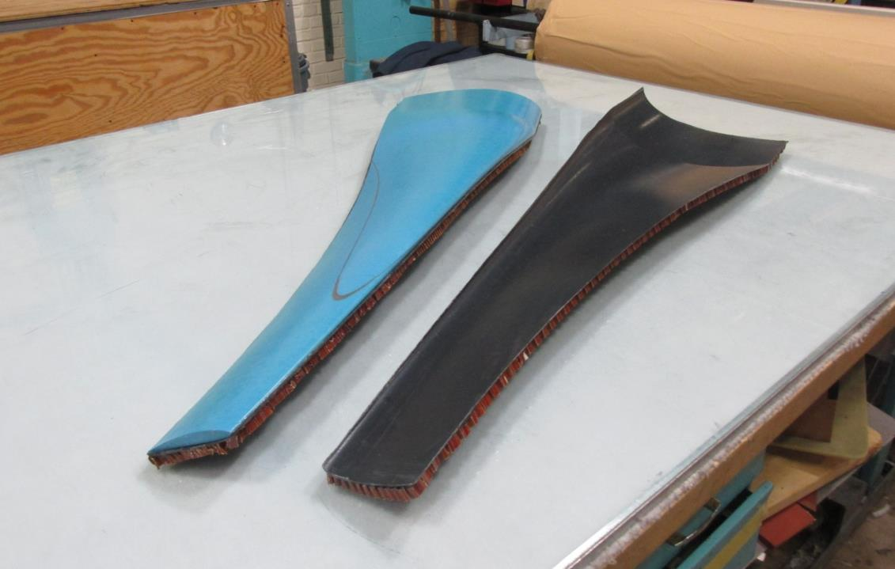
Mold Construction
Exploded view of mold with plug.

Slide 6
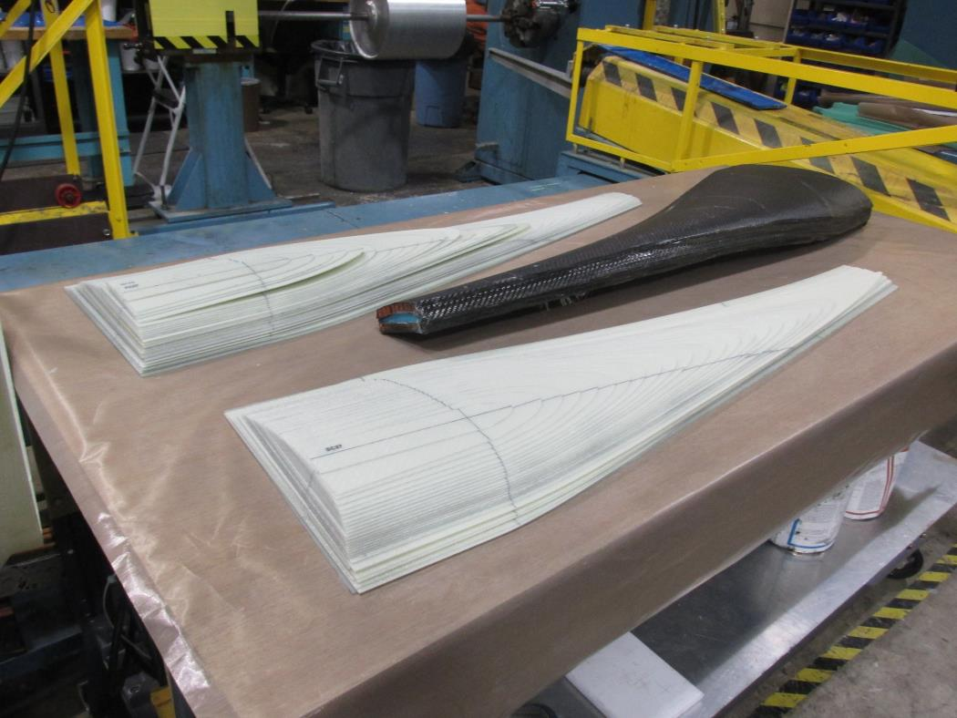
Ply Template Fabrication
A template was made for each ply.

Slide 7
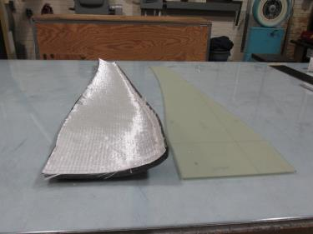
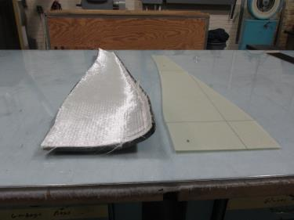
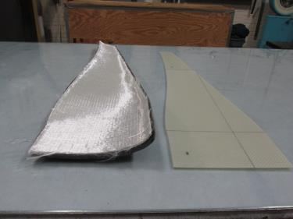
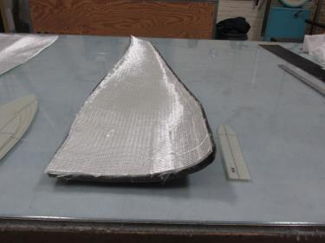
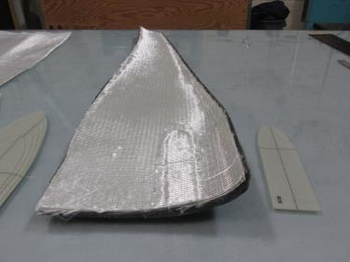
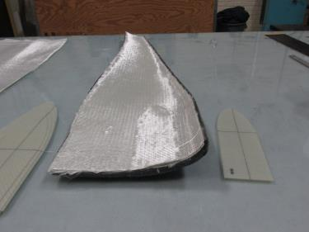
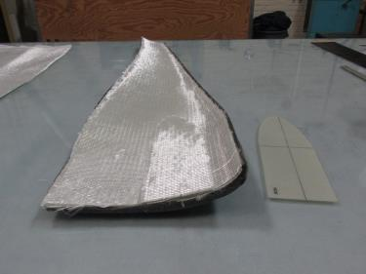
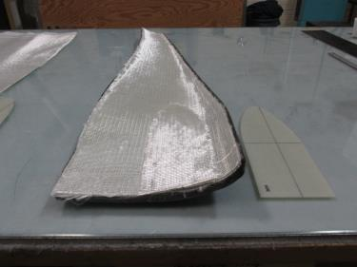
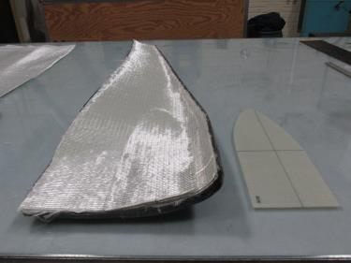
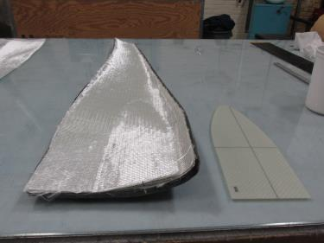
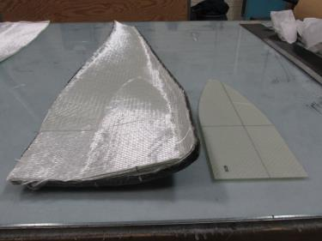
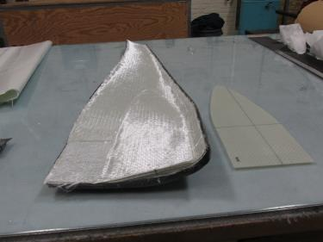
Suction Side Lay-up
SS1
SS2
SS3
SC27
SC26
SC25
SC24
SC23
SC22
SC21
SC20
SC19

Slide 8
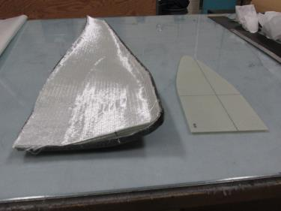
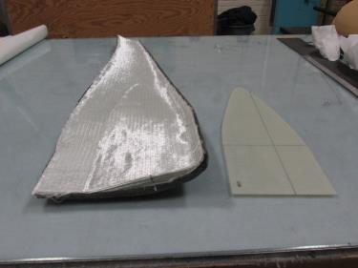
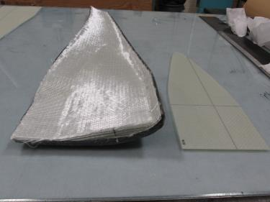
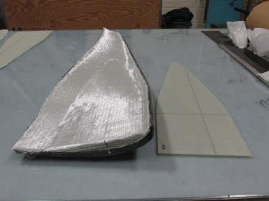
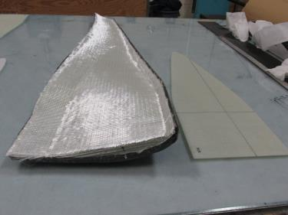
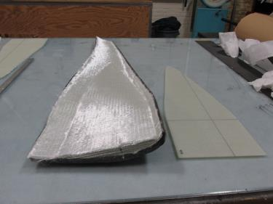
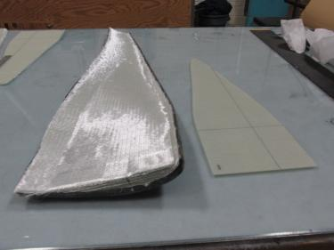
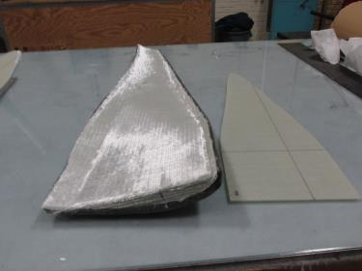
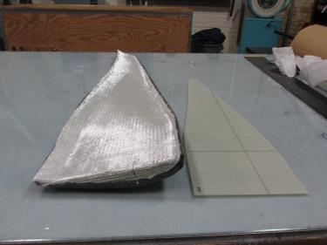
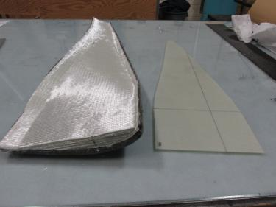
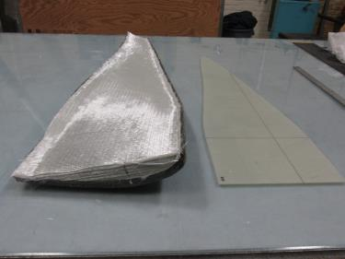
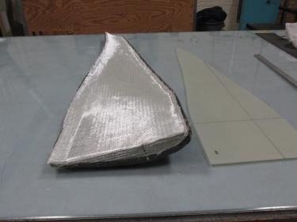
Suction Side Lay-up
SC18
SC17
SC16
SC15
SC14
SC13
SC12
SC11
SC10
SC9
SC8
SC7

Slide 9
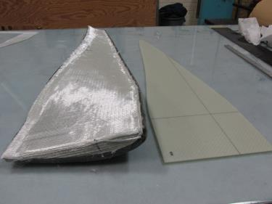
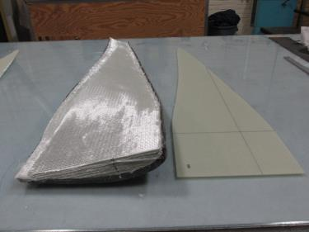
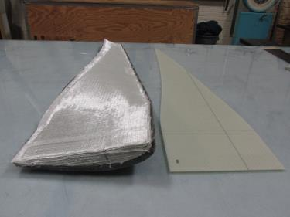
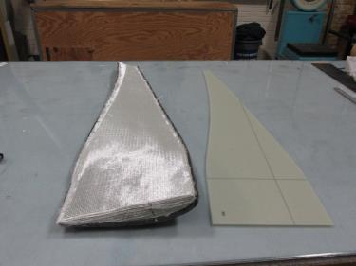
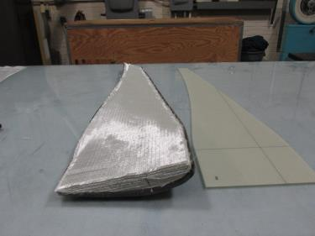
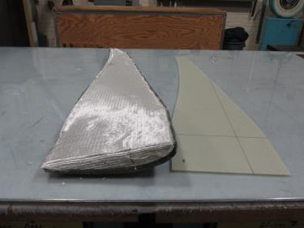
Suction Side Lay-up
SC6
SC5
SC4
SC3
SC2
SC1

Slide 10
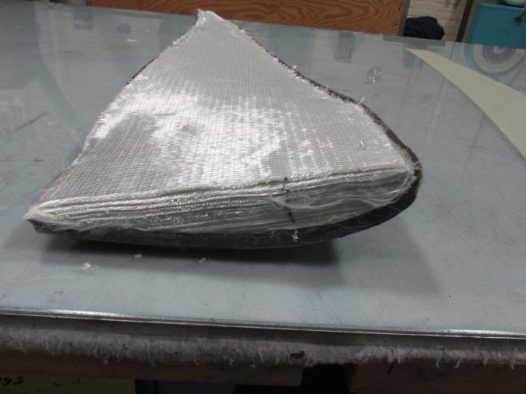
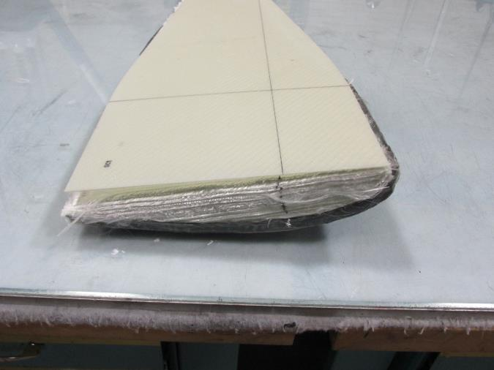
Suction Side Lay-up

Slide 11
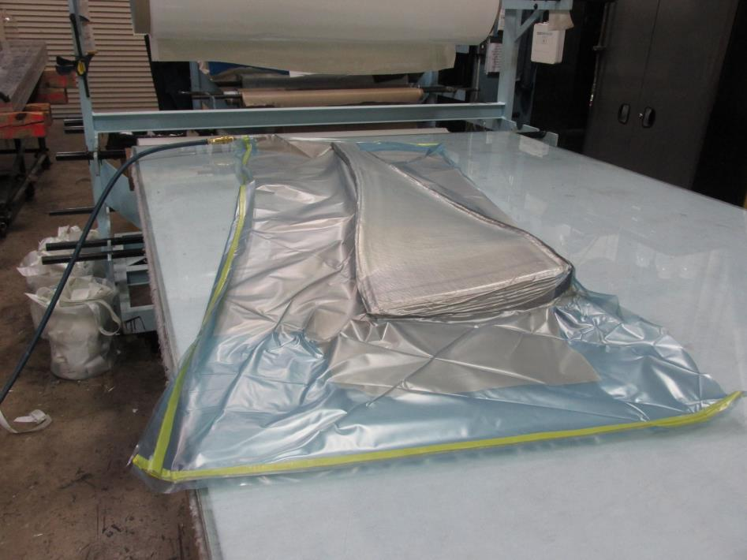
Suction Side Lay-up
Vacuum Bagged for Hot De-bulk

Slide 12
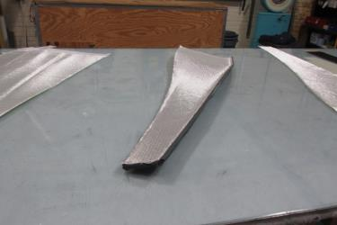
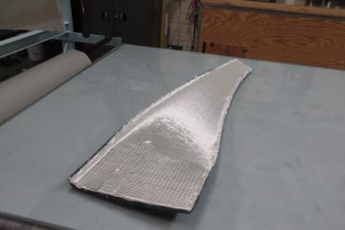
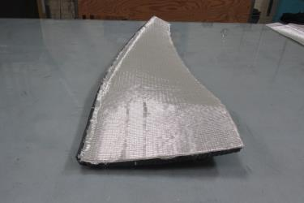
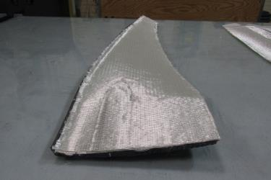
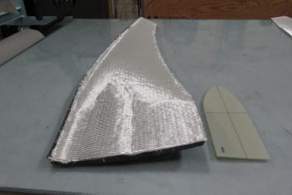







Pressure Side Lay-up
PC27
PS1-PS3
PC26
PC25
PC26
PC24
PC23-PC18
PC17-PC14
PC13-PC10
PC9-PC6
PC5-PC3
PC2
PC1

Slide 13

Pressure Side Lay-up
Vacuum Bagged for Hot De-bulk

Slide 14


Hot De-bulk
The hot de-bulk is the process step that allows low cost, one piece fabrication of the blades.
With out-of-autoclave prepreg fabrication, a vacuum is drawn to remove all the air.
The material is then heated under vacuum for resin infusion to full compaction.
Typically the resin is then cured. In the process being developed for the Verdant turbine blades, the pressure and suction sides are joined prior to cure.
Hot de-bulk; 1 hour at 150 °F.
After hot de-bulk.

Slide 15


Prep for Cure
The thickness at the root should be 1.2” after de-bulk. The measured value was 1.14 - 1.15”.
An additional ply was added to each half as shown below.
This additional ply will be incorporated into the ARL fabrication process since it facilitates alignment of the two halves.

Slide 16


Prep for Cure
The two halves are shown joined below.

Slide 17


Prep for Cure
The mold is vacuum bagged and placed in a 175 °F oven.

Slide 18


After Cure and De-molding
The first fabrication trial indicated that the ARL process is a viable method to fabricate turbine blades in a single step.
The blade shown below was fabricated in about 8 MH.
There was a resin exotherm, but this can be eliminated by placing the mold in an oven at 140 °F.
The main issue is attaining a smooth leading edge.

Slide 19
Path Forward
A minimum of two more single blades will be fabricated prior to proceeding to the three-bladed article.
ARL will fabricate a second mold that attains a smooth parting line at the root and tip and a smooth surface at the leading edge.
The blades will be fabricated by placing them in an oven at 140 °F. With this method cure takes about 24 hours, but is capable of fabricating ST94 prepreg up to 5.5” thick without exotherm.

